Slide 1

Inferring Population Structure Using Genome-Wide SNP analysis on HGDP
David Khachatryan
BMI 776
05 May 2022
1/14

Slide 2


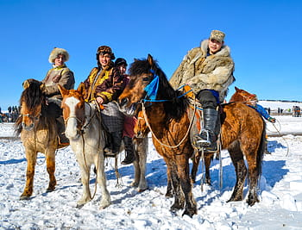






Slide 3
Motivation
Understanding Historical relationships between species
Evolutionary Studies
Correcting Population Stratifications
Human Migration
3/13
3/14

Slide 4

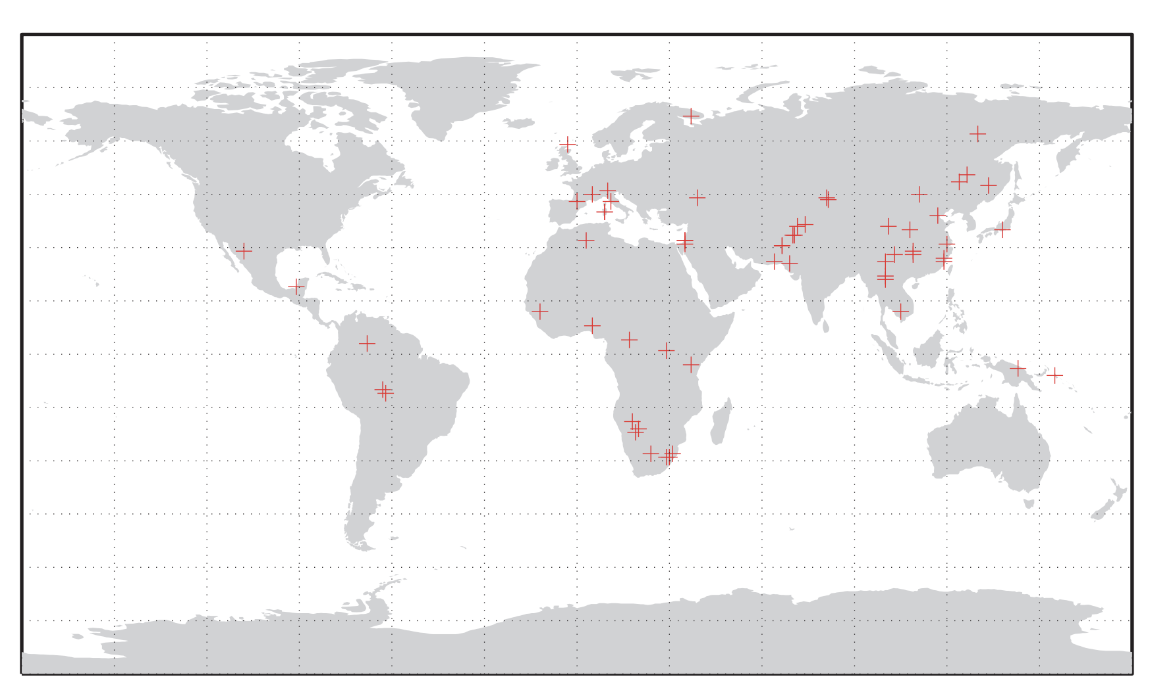
Available Data
Genomic data from 1043 individuals
3/13
4/14
Source: https://www.hagsc.org/hgdp/
4/13

Slide 5
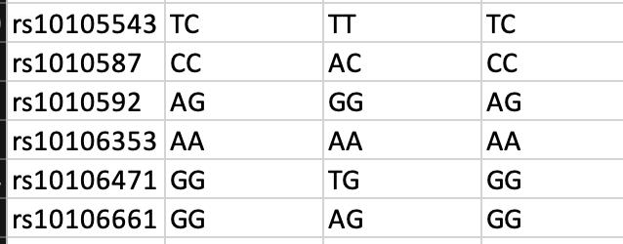
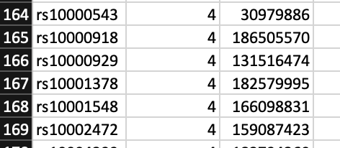
Typical Data
SNP ID
Ind 1 Ind 2 Ind 3
SNP ID Chromosome hg18
And…
Sample Information about Individuals (ethnicity, personal info, etc.)
3/13
5/14
5/13

Slide 6
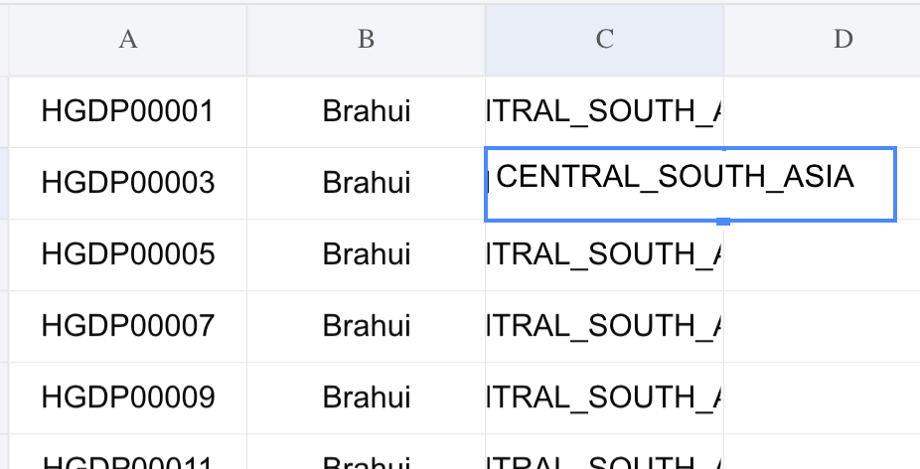
Pre-Processing
HGDP001 HGDP002 HGDP003
IND ETHNICITY REGION
.bed file
3/13
6/14
6/13

Slide 7
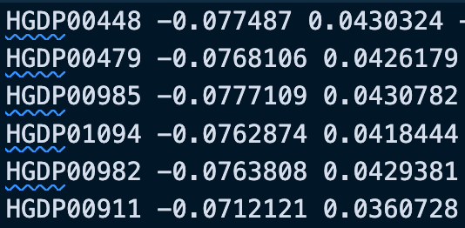
PCA
Using plink to run PCA on .bed file
Getting Eigenvalues and Eigenvectors
Source: https://www.ncbi.nlm.nih.gov/pmc/articles/PMC1950838/
3/13
7/14
7/13

Slide 8
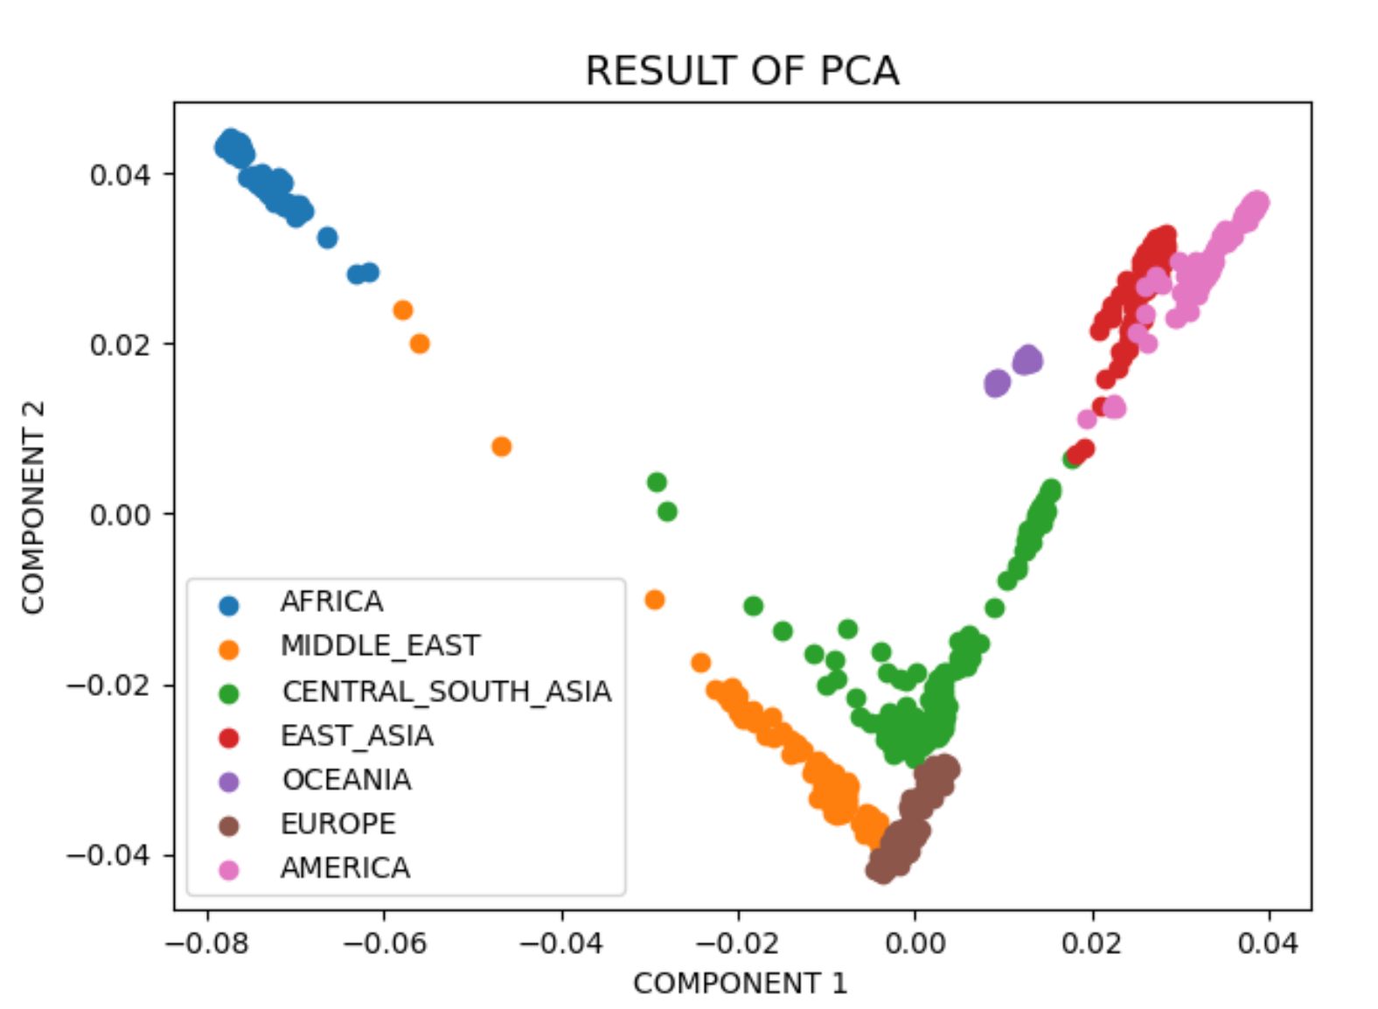
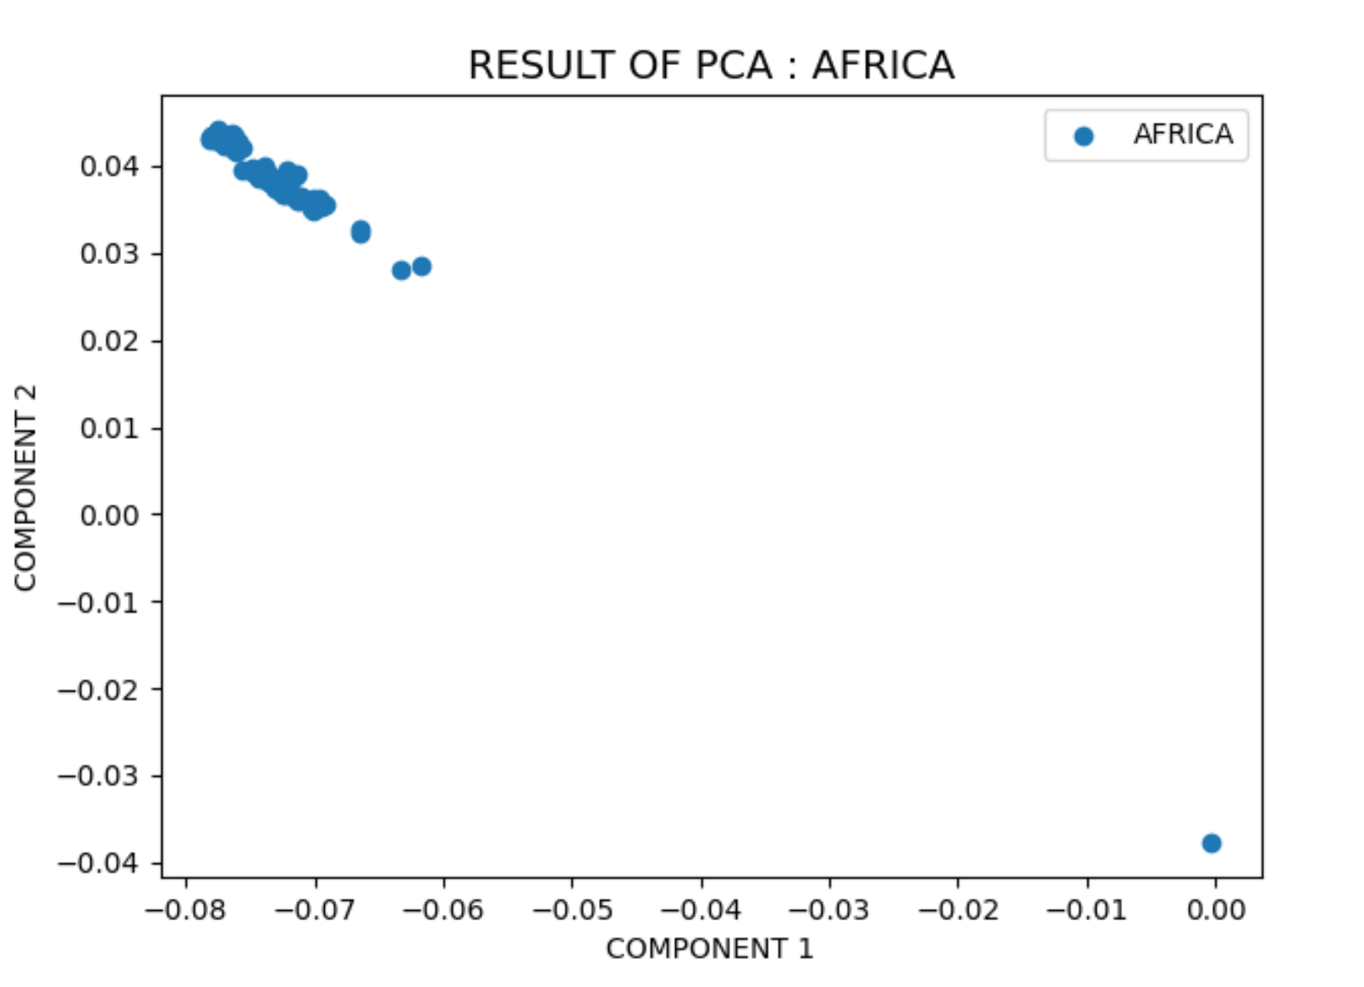
PCA visualization
Regional Visualization
Trivial Visualization
3/13
Source Code: https://github.com/KhachDavid/genome-wide-snp-analysis
8/14
8/13

Slide 9
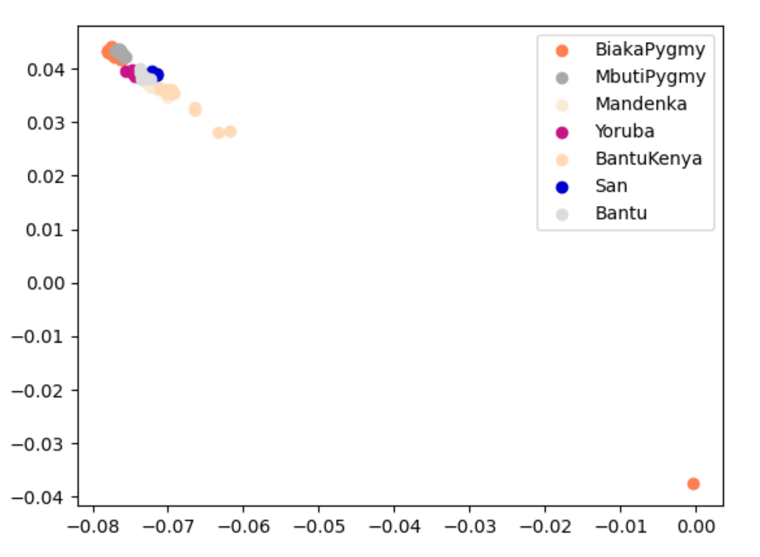
More PCA Visualization
Ethnicities clustered within
3/13
9/13
9/14

Slide 10
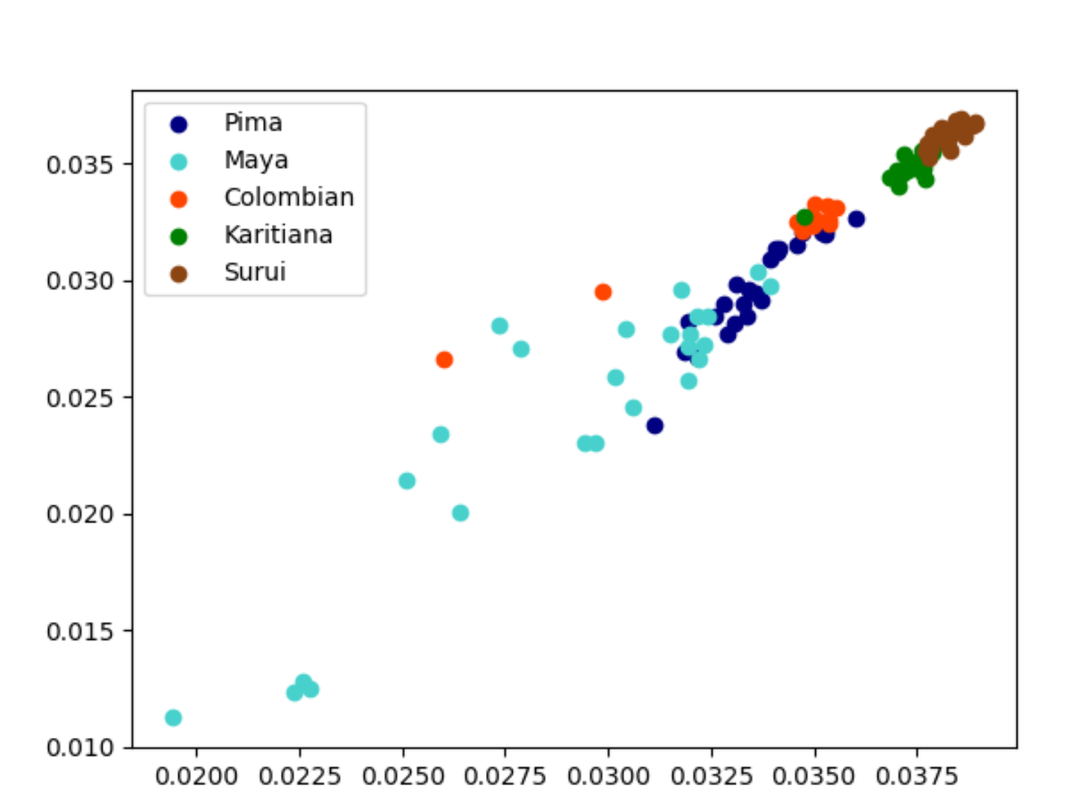
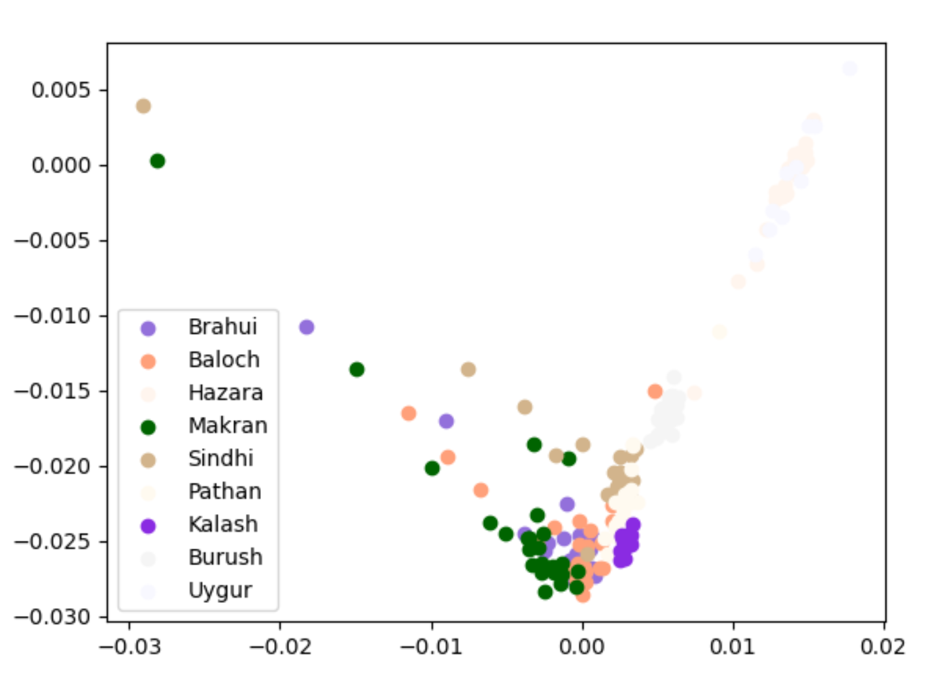
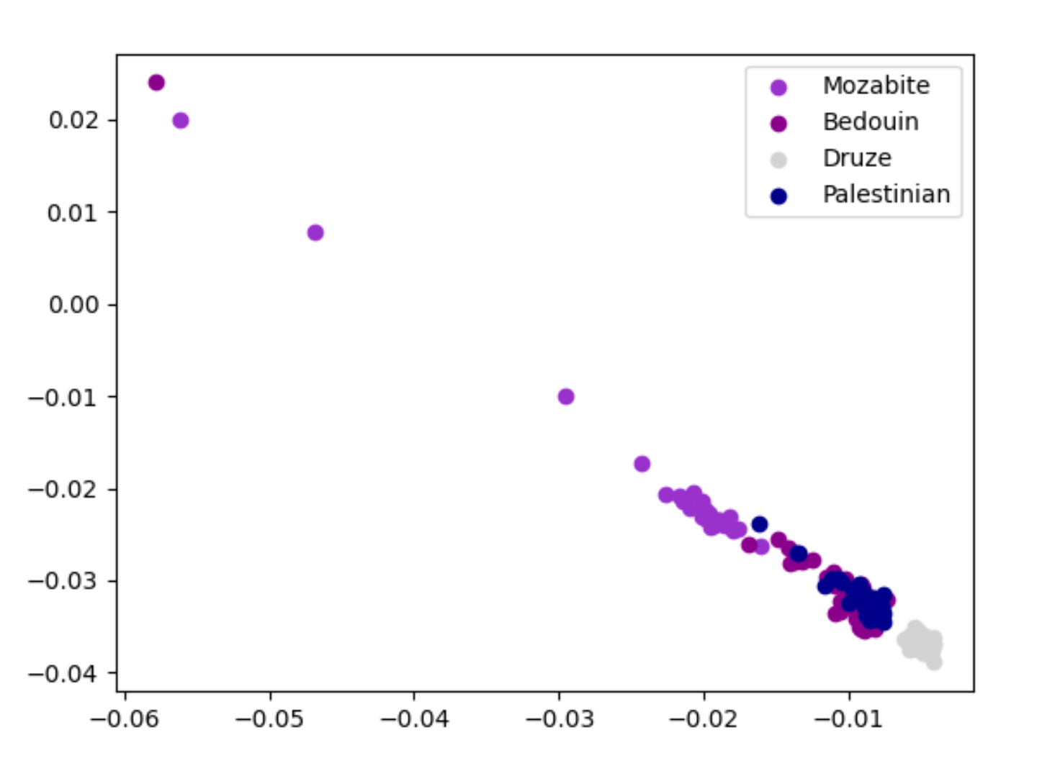
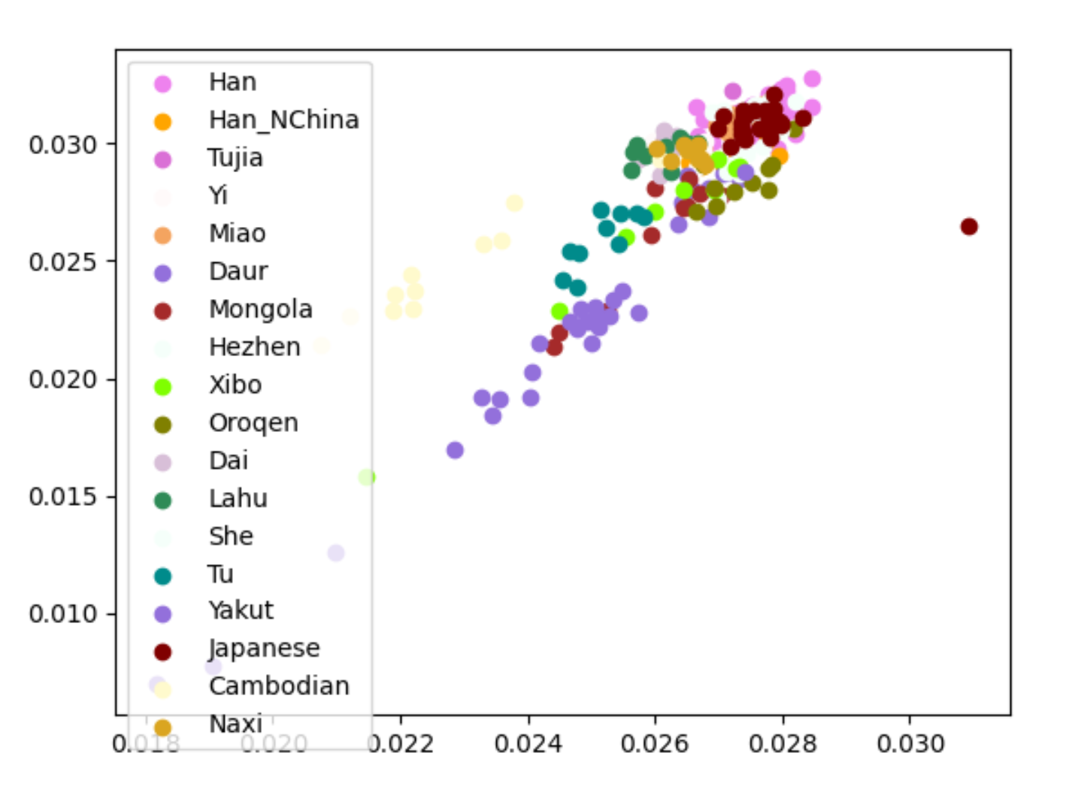
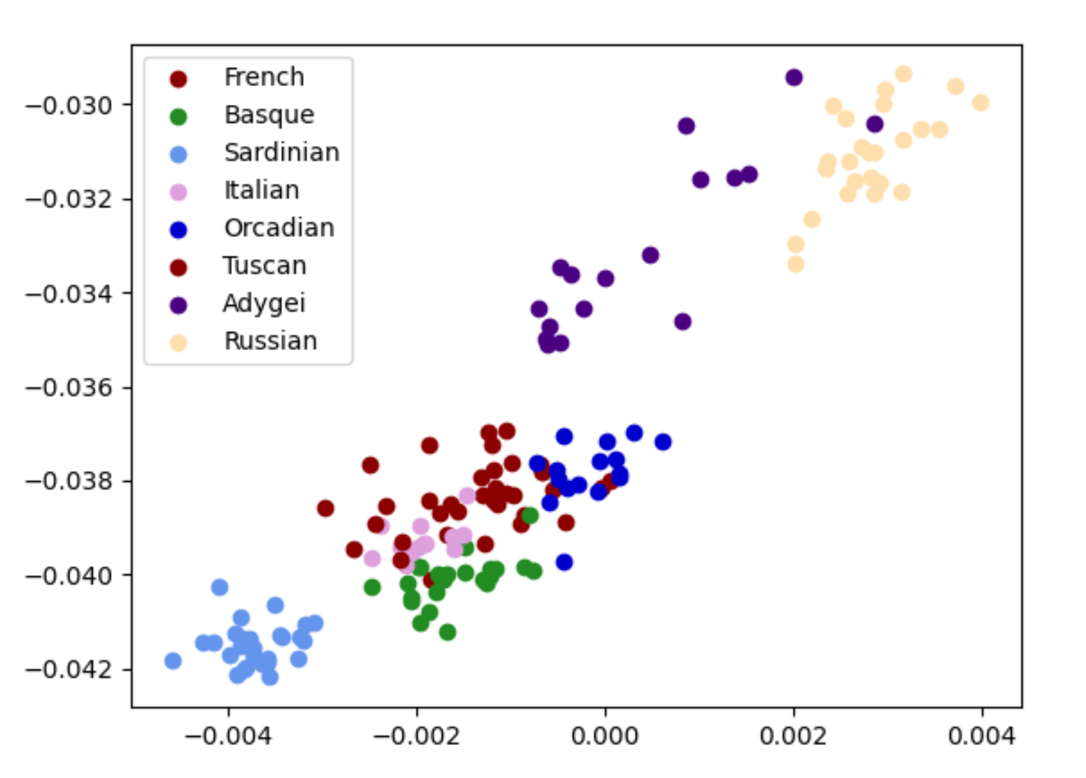
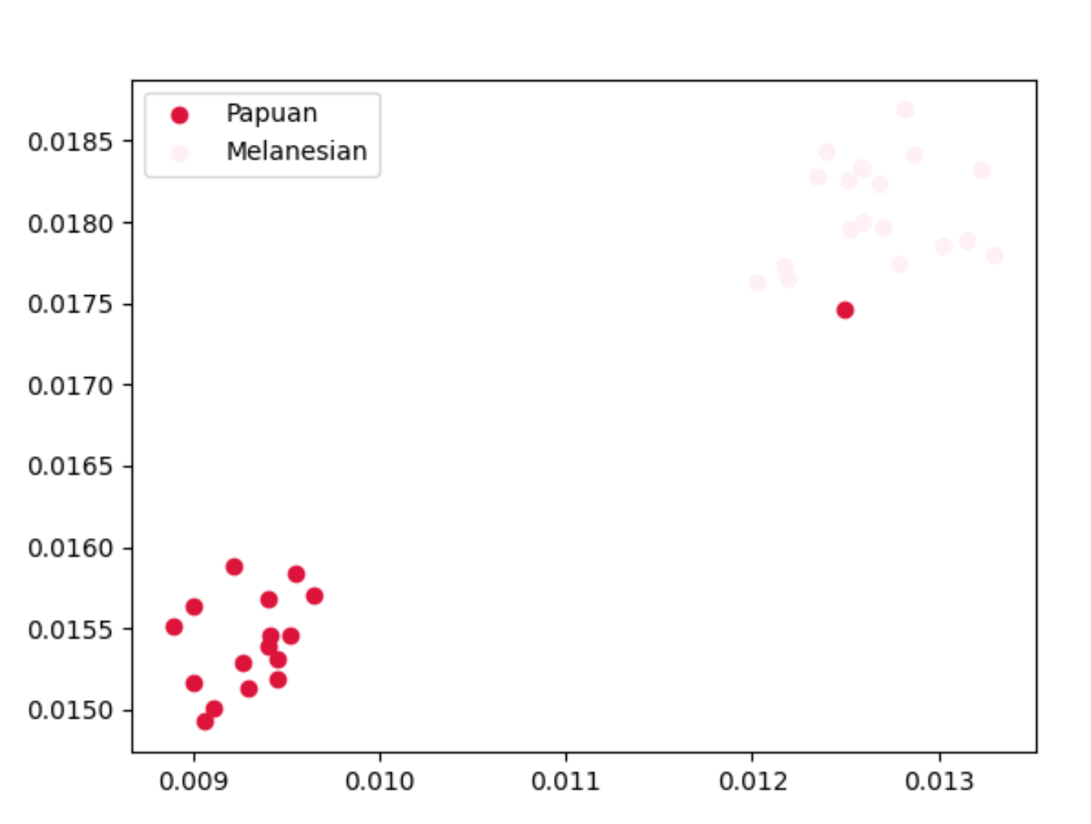
America
Central South Asia
Middle East
East Asia
Europe
Oceania
10/14

Slide 11
Convenient Tool
Submit your own SNP data
Have your samples projected onto the PCA plot and the Tree Mix.
Visualize your population data onto the plots of the Human Genome Discovery Project
Can speed up other research projects relating to population structure inference
11/13
Demo
3/13
11/14

Slide 12
How can we improve?
Admixture and Mixture analysis with TreeMix
Supporting f3 statistical analysis
E.g. Given (A: B, C), show if A is derived from a mixture of population B and C.
12/14
3/13
12/14

Slide 13
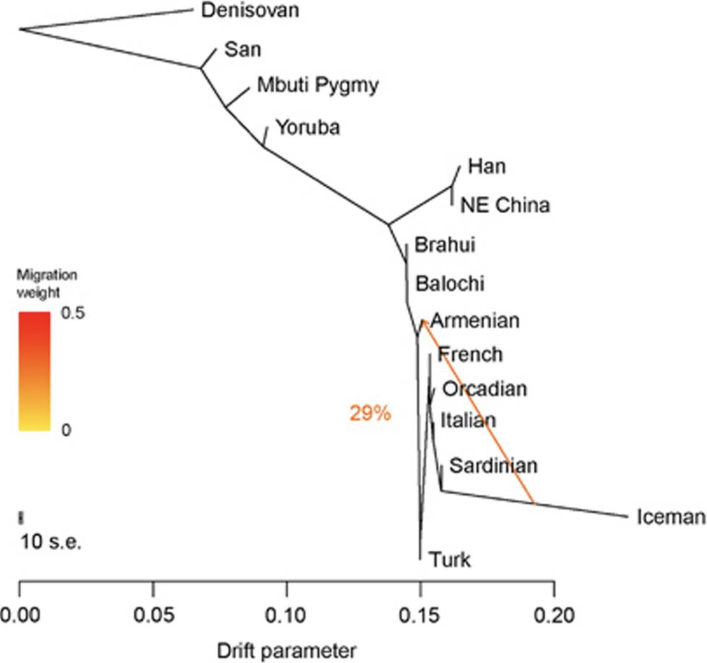
Tree Mix
13/14
Source: https://www.ncbi.nlm.nih.gov/pmc/articles/PMC3499260/
3/13
13/14

Slide 14
Summary
PCA can be used for population structure inference
Extending the HGDP data
Open Source Tool for plotting customly obtained SNP data onto HGDP-based PCA
3/13
Thank you!
14/14
14/14

